Slide 1

Bank Loan Case Study

Slide 2

Project Description
Performing Exploratory Data analysis (EDA) to analyse patterns in data for a finance company that specializes in lending various types of loans to urban customers and ensuring that capable applicants are not rejected.
Company faces two types of risks:
If the applicant can repay the loan but is not approved, the company loses business.
If the applicant cannot repay the loan and is approved, the company faces a financial loss.
The dataset consists of customers with payment difficulty and with no payment difficulties. The main aim of this project is to use EDA to understand how customer attributes and loan attributes influence the likelihood of default. Stakeholders will decide whether to deny the loan, reducing the amount of the loan or lending at higher interest rate.
I am going to clean the dataset, identify and handle the Outliers, perform univariate, bivariate analysis to summarize about a variable and as well as to compare two variables, measure the correlation between the attributes and calculate the imbalance in the data to understand the key factors behind loan default.

Slide 3
Tech Stack used
Ms Excel office 2016
A spreadsheet software where data can be stored in tabular format, cleaned and analysed to obtain meaningful insights for data-driven decisions.
For EXCEL FILE CLICK HERE
Ms PowerPoint 2016
A powerful presentation maker used to create slideshow of valuable information through charts, and images.

Slide 4
Approach
Ask:
Stakeholders want us to answer these questions to make decisions about issuing the loans to the customers.
Identifying the missing data and deal with it appropriately and visualize the proportion of missing values for each variable.
Identifying Outliers in the dataset, determine whether their valid or require further investigation and visualize the distribution of numerical variables and highlight the Outliers.
Analyze Data imbalance by comparing the class frequencies to assess data imbalance.
Perform Univariate, Segmented Univariate, Bivariate Analysis to gain insights into the driving factors of loan default and create heatmaps to visualize the relationships between variables and target variable.
Identify top correlations for different scenarios and visualize the correlations using heatmaps.

Slide 5
Prepare:
Download the dataset called application_data which provide information about current loan applications.
This dataset have 122 columns and 49,999 rows.
Save this file as .xlsx file.
Process: Here cleaning and the identifying the outliers take place.
Analyze: I am going to clean and analyse the data,

Slide 6
Identify Missing Data and Deal With it Appropriately:
Identifying the missing data in the loan application dataset by utilizing Excel functions and handle them by using functions like average and median for imputation or other appropriate methods to ensure the accuracy of the analysis.
Creating a bar chart to visualize the proportion of missing values for each variable.
Duplicate the dataset to handle them, so that original dataset is not changed.

Slide 8
Insights:
50 columns have more than 30% of missing values but OCCUPATION_TYPE column is important for our analysis except that we remove all 49 columns.
OCCUPATION_TYPE missing values will be filled with most frequently occurring values With Respect to NAME_EDUCATION_TYPE and NAME_INCOME_TYPE column.
Some unnecessary columns are removed,
NAME_TYPE_SUITE missing values is filled with “Unaccompanied”.
AMT_GOODS_PRICE is same as the AMT_CREDIT column, we fill the values of AMT_GOODS_PRICE corresponding to the AMT_CREDIT values.
AMT_ANNUITY, CNT_FAMILY_MEMBERS missing rows are filled with their respective median values, due to the presence of outliers in the data.

Slide 9
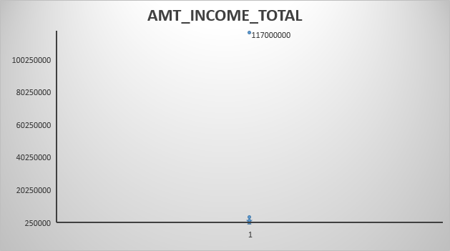
B. Identify the Outliers in the Dataset: Outliers can significantly impact the analysis and distort the results. Detecting and identifying the outliers for numerical values in the loan application dataset. Creating the box plot to visualize the distribution of the numerical variables and highlight the outliers.
In AMT_INCOME_TOTAL column have Outliers but one in particular one, The maximum value is 117000000. which is the wrong income as the Occupation of the person is Labourer and it needs further investigation. I am going to replace this data point by median value. Median of Amt_income: 145800.

Slide 10
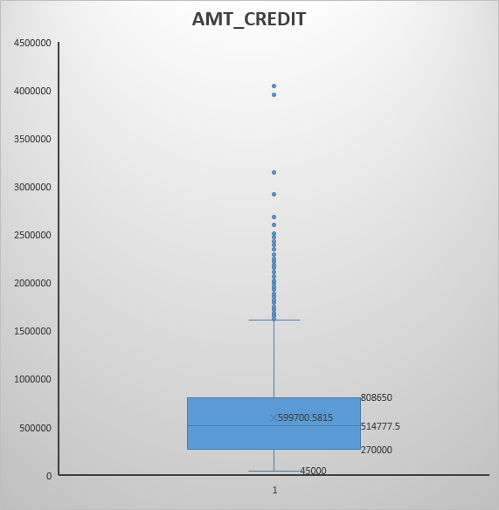
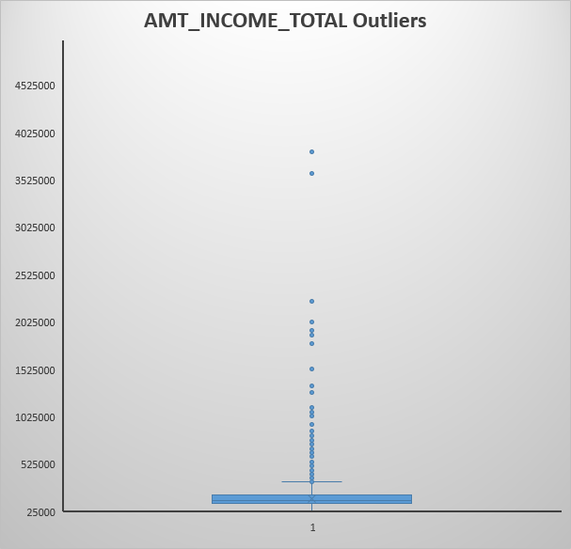

Slide 11
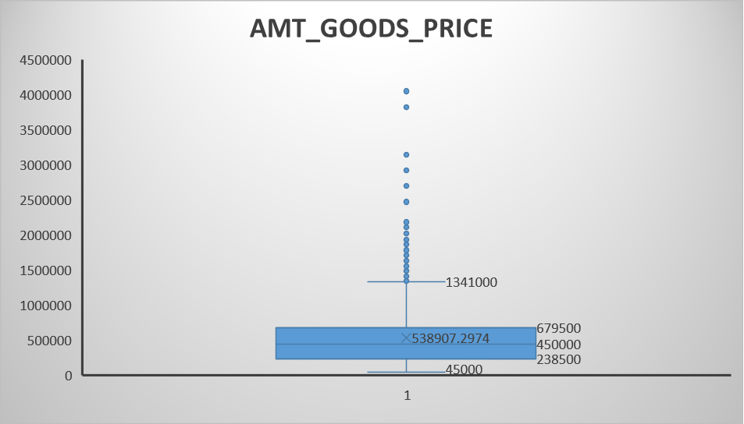
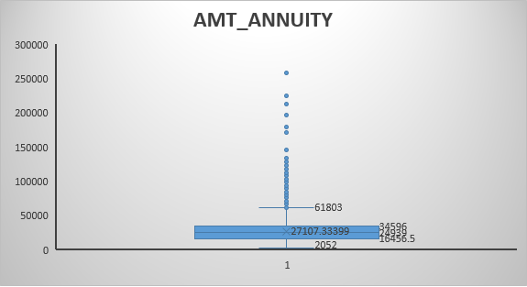
After replacing the value, we will get the outliers common for different occupations and education levels.
AMT_CREDIT, AMT_ANNUITY, AMT_GOODS_PRICE have no issues with outliers. They matches with income of the Clients.

Slide 12
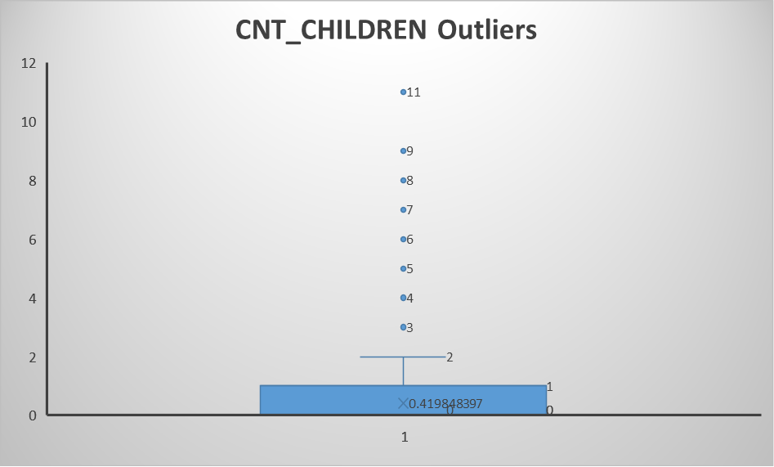
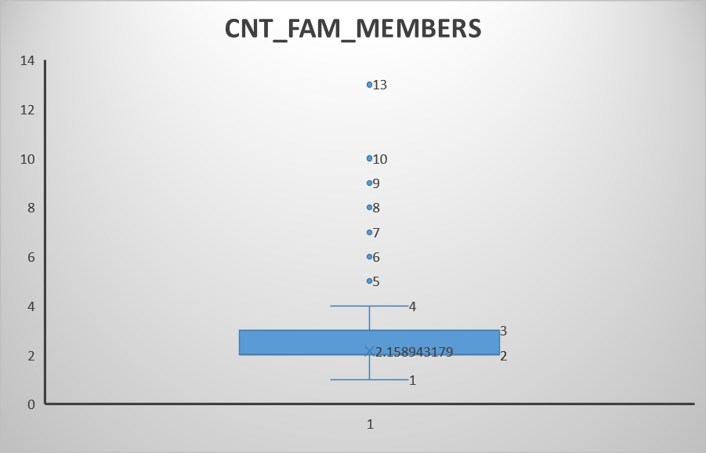
CNT_CHILDREN column outliers perfectly matched with CNT_FAM_MEMBERS. So, we have no issue here.

Slide 13
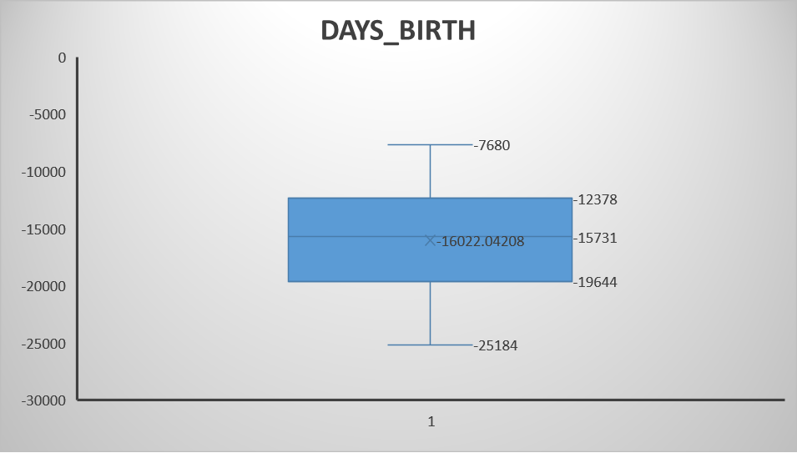
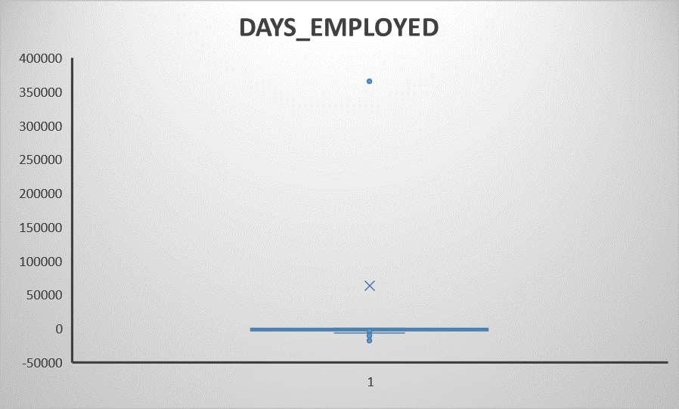
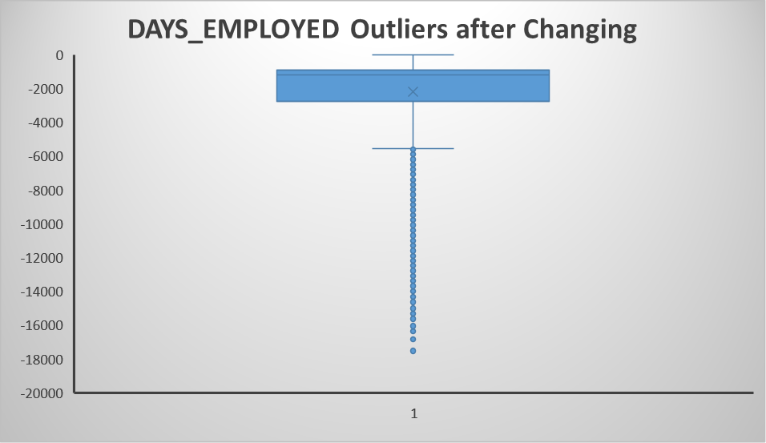
36,5243
As these are the columns started before applying for the loan. So, there are in negative values as 0 day being the day they applied for loan.
But in DAYS_EMPLOYED Column we have positive values i.e., 365243 days which is impossible because it will be 1000 years. It seems there is a typing mistake. So I am going to replace it with the median value of the column.
Median of DAYS_EMPLOYED : -1221.
Second Box chart shows that extreme value is removed and we have no issue with them.

Slide 14
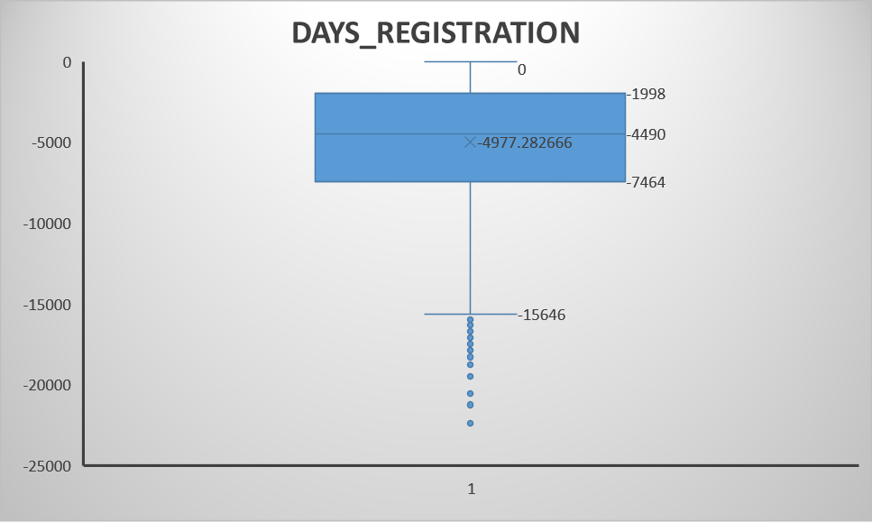
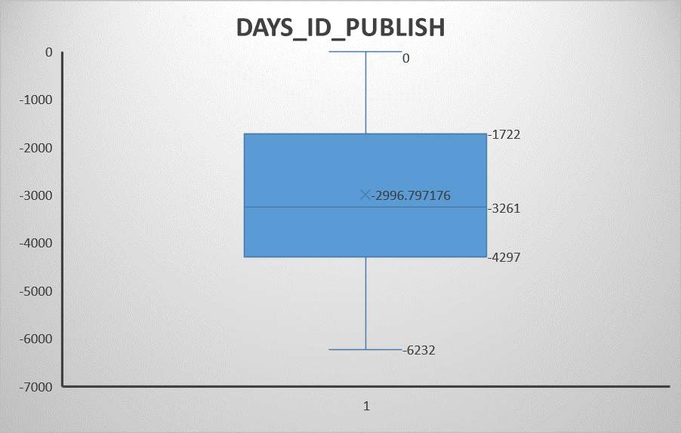
The remaining columns DAYS_REGISTRATION i.e., days before the client changed his application and the column DAYS_ID_PUBLISH Where the client changes their ID doesn't have any changes and outliers seems to be the correct data.

Slide 15
C. Analyze Data Imbalance: A classification dataset with skewed class proportions is called imbalanced. Data imbalance can affect the accuracy of the analysis, especially for binary classification problems. Determining if there is data imbalance in the loan application dataset. Bar chart to visualize the distribution of the target variable.
Classes that make up a large proportion of the dataset are called “Majority classes” and smaller proportion classes are called “Minority Classes”
TARGET column have two values:
0 - Clients with no payment difficulties
1 – Clients with Payment difficulties i.e., he/she who had late payments more than X days.
We can check for data imbalance with following table,
Degree of imbalance | Proportion of Minority Class
Mild | 20-40% of the data set
Moderate | 1-20% of the data set
Extreme | <1% of the data set

Slide 16
Target: We can see that clients with payment difficulties are lesser proportion i.e., 8.05% only. So, it is a minority class in the dataset and moderate degree of imbalance.
Contract_type: Revolving loans are the minority class in this about 9.45% of the total loans. It also have moderate degree of imbalance.
Gender: Here the female proportion is more than males which makes it a minority class and only mild degree of imbalance.

Slide 17
D. Perform Univariate, Segmented univariate, Bivariate Analysis:
To gain insights into the driving factors of loan default, it is important to conduct various analyses on consumer and loan attributes.
Univariate Analysis: Perform univariate analysis to understand the distribution of individual variables. Univariate Involves the measurement or observation of a single characteristic or a single attribute in the dataset. It does not explore relationships between variables or attempt to identify causes.
Histograms, box plots, and other graphical representations are often used to visually represent the distribution of the single variable.

Slide 18
Here, Cash loans are more than the revolving loans. Most of the clients want cash in hand rather then borrowing at a approved limit.
More Females clients than Males clients.
Majority of the applicants doesn't own a car.
Many clients have their own houses or flats and this can be kept as surety but need further investigation.
As these are categorical variables, the frequency of the data is used to understand the distribution of the data.

Slide 19
Everyone Given their mobile num.
Only 6% of the Clients have provided emails but the remaining 94% doesn't.

Slide 20
Small families of 2 members are most common in the dataset.
Mean: 2.16
Median of Num_of_Family: 2
About 70% of the clients doesn't have children and 20% of the clients have a single child.
Mean of num_of_children: 0.42
Median of num_of_children: 0

Slide 21
Clients with secondary/ secondary special is more than the clients of other education type. Needs other variables to investigate further.
Laborers are the majority of the applicants and many of them have only secondary/secondary education. They will be in lower income levels.

Slide 22
Majority of the clients have income range between 1lakh to 1.5lakhs only and the people above 5 Lakhs income are the outliers. As, there are Outliers, we consider median,
Median of Income Range: 145800
The credit amount of the loan for most clients is 2lakhs to 3lakhs and above 16lakhs credit amount falls under outliers. As, there are Outliers, we consider median,
Median of Credit Amount: 514777.5

Slide 23
Most occurring annuity of the loan is 20,000 to 30,000 and above 80k is considered outliers. As, there are Outliers, we consider median,
Median of Annuity Amount: 24939
Goods price is same as credit Amount so, the chart is similar. As, there are Outliers, we consider median,
Median of Goods_Price: 450000

Slide 24
ii. Segmented Univariate Analysis: In segmented univariate analysis, we segment the categorical variables and then perform univariate analysis across its categories. We will Compare variable distributions for different Scenarios. We use Median values to compare the values. Heatmaps are used to visualize this,
Factors influencing AMT_INCOME column
Gender | Median of Income |  | Contract_type | Median of Income
F | 135000 |  | Cash loans | 153000
M | 180000 |  | Revolving loans | 135000
Own_car | Median of Income |  | Own house/car | Median of Income
Y | 180000 |  | Y | 148500
N | 135000 |  | N | 144000
Children | Median of Income
0 | 141750
1 | 157500
2 | 157500
3 | 157500
4 | 135000
5 | 193500
6 | 157500
7 | 132750
8 | 112500
9 | 180000
11 | 315000
Family_nums | Median of Income
1 | 135000
2 | 148500
3 | 157500
4 | 157500
5 | 157500
6 | 135000
7 | 213750
8 | 157500
9 | 132750
10 | 146250
13 | 315000

Slide 25
Age |  |  | Employment in years
Row Labels | Average of AMT_INCOME_TOTAL |  | Row Labels | Average of AMT_INCOME_TOTAL
21-26 | 148589 |  | 0-5 | 160842
26-31 | 167063 |  | 5-10 | 179684
31-36 | 178738 |  | 10-15 | 185088
36-41 | 179149 |  | 15-20 | 184740
41-46 | 181944 |  | 20-25 | 171640
46-51 | 178495 |  | 25-30 | 173676
51-56 | 168177 |  | 30-35 | 176165
56-61 | 156282 |  | 35-40 | 193919
61-66 | 139299 |  | 40-45 | 206196
66-71 | 112743 |  | 45-50 | 123750
Education | Median of Income
Academic degree | 171000
Higher education | 180000
Incomplete higher | 157500
Lower secondary | 112500
Secondary / secondary special | 135000
Family_Status | Median of Income
Civil marriage | 144000
Married | 157500
Separated | 157500
Single / not married | 144000
Unknown | 450000
Widow | 129600
Income_type | Median of Income
Businessman | 1575000
Commercial associate | 180000
Maternity leave | 360000
Pensioner | 112500
State servant | 157500
Student | 144000
Unemployed | 117000
Working | 135000
Housing_type | Median of Income
Co-op apartment | 157500
House / apartment | 148500
Municipal apartment | 157500
Office apartment | 157500
Rented apartment | 157500
With parents | 135000

Slide 26
Insights:
I have calculated the median of the income for the segmented categorical variables.
Males have more income than females.
Middle aged clients and clients with more employed years are the top earners.
Clients taking cash loans have more income than the clients with Revolving loans.
Clients who have their own car and own house have more income.
Clients with large family and children have maximum income than others.
Education is also an important factor that govern the income levels. Clients with higher education and in high position like businessman, managers have more income.
Occupation | Median of Income
Accountants | 171000
Cleaning staff | 112500
Cooking staff | 126000
Core staff | 157500
Drivers | 180000
High skill tech staff | 162000
HR staff | 147150
IT staff | 180000
Laborers | 144000
Low-skill Laborers | 135000
Managers | 225000
Medicine staff | 135000
Private service staff | 157500
Realty agents | 180000
Sales staff | 135000
Secretaries | 135000
Security staff | 135000
Unemployed | 112500
Waiters/barmen staff | 135000

Slide 27
Factors influencing AMT_CREDIT
Gender | Median of Credit |  | Contract_type | Median of Credit
F | 512064 |  | Cash loans | 542133
M | 521280 |  | Revolving loans | 270000
Own_car | Median of Credit |  | Own house/car | Median of Credit
Y | 547344 |  | Y | 508495.5
N | 491031 |  | N | 523597.5
Children | Median of Credit |  | Family_nums | Median of Credit
0 | 513000 |  | 1 | 444420
1 | 509400 |  | 2 | 540000
2 | 521280 |  | 3 | 521280
3 | 544765.5 |  | 4 | 521280
4 | 474183 |  | 5 | 545040
5 | 450000 |  | 6 | 474115.5
6 | 642600 |  | 7 | 514597.5
7 | 850081.5 |  | 8 | 642600
8 | 755190 |  | 9 | 850081.5
9 | 640080 |  | 10 | 697635
11 | 1007761.5 |  | 13 | 1007761.5
Education | Median of Credit
Academic degree | 674743.5
Higher education | 566055
Incomplete higher | 454500
Lower secondary | 450000
Secondary / secondary special | 497520
Income_type | Median of Credit
Businessman | 1800000
Commercial associate | 555273
Maternity leave | 765000
Pensioner | 454500
State servant | 576992.25
Student | 381528
Unemployed | 585000
Working | 497520
Family_Status | Median of Credit
Civil marriage | 454500
Married | 545040
Separated | 473904
Single / not married | 432661.5
Unknown | 675000
Widow | 422451
Housing_type | Median of Credit
Co-op apartment | 364896
House / apartment | 521280
Municipal apartment | 528633
Office apartment | 512064
Rented apartment | 450000
With parents | 432661.5

Slide 28
Age |  |  | Employee_years
Row Labels | Average of AMT_CREDIT |  | Row Labels | Average of AMT_CREDIT
21-26 | 420630 |  | 0-5 | 567590
26-31 | 520839 |  | 5-10 | 631382
31-36 | 583139 |  | 10-15 | 665936
36-41 | 632597 |  | 15-20 | 688751
41-46 | 657133 |  | 20-25 | 697039
46-51 | 662944 |  | 25-30 | 648249
51-56 | 657582 |  | 30-35 | 757543
56-61 | 639216 |  | 35-40 | 753870
61-66 | 563562 |  | 40-45 | 716625
66-71 | 233075 |  | 45-50 | 184489
Insights:
Here Credit amount means the amount of the loan credited.
These credit amount have positive correlation with the clients as well as with the goods price. So ,credit amount increases if the other two variables increases.
For consumer loans, the price of the goods is equal to the credit amount of the loan. This may be a surety for the banks.
So a male with more income, middle age, having high education like academic degree and occupy higher positions such as business mans or managers who have 30-40 years of experience have higher credit values.
Occupation | Median of Credit
Accountants | 629325
Cleaning staff | 450000
Cooking staff | 450000
Core staff | 533304
Drivers | 540000
High skill tech staff | 592560
HR staff | 544491
IT staff | 565020
Laborers | 495000
Low-skill Laborers | 370629
Managers | 675000
Medicine staff | 521280
Private service staff | 518562
Realty agents | 545040
Sales staff | 481495.5
Secretaries | 454500
Security staff | 495000
Unemployed | 454500
Waiters/barmen staff | 450000

Slide 29
Factors influencing AMT_Annuity
Gender | Median of Annuity |  | Contract_type | Median of Annuity
F | 24075 |  | Cash loans | 26136
M | 26446.5 |  | Revolving loans | 13500
Own_car | Median of Annuity |  | Own house/car | Median of Annuity
Y | 27301.5 |  | Y | 24948
N | 23764.5 |  | N | 24840
Children | Median of Annuity |  | Family_nums | Median of Annuity
0 | 24561 |  | 1 | 22032
1 | 25636.5 |  | 2 | 25636.5
2 | 25785 |  | 3 | 26217
3 | 26928 |  | 4 | 26010
4 | 23809.5 |  | 5 | 27362.25
5 | 24669 |  | 6 | 23910.75
6 | 24747.75 |  | 7 | 25058.25
7 | 29634.75 |  | 8 | 24747.75
8 | 29947.5 |  | 9 | 29634.75
9 | 31131 |  | 10 | 30539.25
11 | 38515.5 |  | 13 | 38515.5
Education | Median of Annuity
Academic degree | 30548.25
Higher education | 27814.5
Incomplete higher | 25526.25
Lower secondary | 22149
Secondary / secondary special | 24052.5
Income_type | Median of Annuity
Businessman | 90000
Commercial associate | 27661.5
Maternity leave | 76500
Pensioner | 21775.5
State servant | 26781.75
Student | 22311
Unemployed | 24599.25
Working | 24792.75
Family_Status | Median of Annuity
Civil marriage | 22905
Married | 26316
Separated | 22779
Single / not married | 22437
Unknown | 33750
Widow | 20407.5
Housing_type | Median of Annuity
Co-op apartment | 22365
House / apartment | 25056
Municipal apartment | 25218
Office apartment | 24750
Rented apartment | 24363
With parents | 22761

Slide 30
Age |  |  | Employee Years
Row Labels | Average of AMT_ANNUITY |  | Row Labels | Average of AMT_ANNUITY
21-26 | 22006 |  | 0-5 | 26027
26-31 | 26236 |  | 5-10 | 28566
31-36 | 27721 |  | 10-15 | 29129
36-41 | 28283 |  | 15-20 | 29660
41-46 | 29003 |  | 20-25 | 29354
46-51 | 28734 |  | 25-30 | 27028
51-56 | 28044 |  | 30-35 | 31390
56-61 | 26728 |  | 35-40 | 31978
61-66 | 24444 |  | 40-45 | 31840
66-71 | 17704 |  | 45-50 | 12191
Insights:
AMT_ANNUITY is the loan annuity which means it is a fixed amount to be repaid to the lender in instalments.
Annuity depends directly on loan credit. As the credit of the loan increases, the annuity also increases.
So if the credit is high, the repayment in instalments is also high.
Occupation | Median of Annuity
Accountants | 28570.5
Cleaning staff | 21672
Cooking staff | 23089.5
Core staff | 25969.5
Drivers | 27540
High skill tech staff | 27427.5
HR staff | 25375.5
IT staff | 26896.5
Laborers | 24750
Low-skill Laborers | 21865.5
Managers | 31576.5
Medicine staff | 23773.5
Private service staff | 26316
Realty agents | 27882
Sales staff | 24435
Secretaries | 22034.25
Security staff | 23980.5
Unemployed | 21775.5
Waiters/barmen staff | 23114.25

Slide 31
iii. Bivariate Analysis: In Bivariate analysis, Bivariate data involves two different variables, and the analysis of this type of data focuses on understanding the relationship or association between these two variables. Create heatmaps to visualize the relationships between variables and the target variable.
Factors influencing AMT_INCOME column
 |  | Gender
 |  | F | M
Target | 0 | 135000 | 180000
 | 1 | 135000 | 157500
 |  | Contract_Type
 |  | Cash loans | Revolving loans
Target | 0 | 157500 | 135000
 | 1 | 138588.75 | 121500
 |  | Target
 |  | 0 | 1
Education | Academic degree | 171000 | 0
 | Higher education | 180000 | 180000
 | Incomplete higher | 157500 | 159750
 | Lower secondary | 112500 | 112500
 | Secondary / secondary special | 135000 | 135000
 |  | Own_car
 |  | Y | N
Target | 0 | 180000 | 135000
 | 1 | 157500 | 135000
 |  | Own_House/Flat
 |  | Y | N
Target | 0 | 153000 | 144000
 | 1 | 144000 | 135000
 |  | Target
 |  | 0 | 1
Family_Status | Civil marriage | 144000 | 157500
 | Married | 157500 | 135000
 | Separated | 157500 | 135000
 | Single / not married | 148500 | 135000
 | Unknown | 450000 | 0
 | Widow | 130500 | 126000

Slide 32
Age in Years |  |  |  | Employment Years
Average of AMT_INCOME_TOTAL | Column Labels |  |  | Average of AMT_INCOME_TOTAL | Column Labels
Row Labels | 0 | 1 |  | Row Labels | 0 | 1
21-26 | 150069 | 137156 |  | 0-5 | 161255 | 156697
26-31 | 168075 | 159083 |  | 5-10 | 180198 | 173457
31-36 | 180434 | 162883 |  | 10-15 | 185340 | 180635
36-41 | 180301 | 167599 |  | 15-20 | 186135 | 156605
41-46 | 181925 | 182168 |  | 20-25 | 172928 | 147042
46-51 | 179121 | 170606 |  | 25-30 | 173468 | 180000
51-56 | 168715 | 159639 |  | 30-35 | 178087 | 130327
56-61 | 156449 | 153452 |  | 35-40 | 195167 | 103500
61-66 | 139677 | 132451 |  | 40-45 | 206196
66-71 | 112549 | 117025 |  | 45-50 | 123750
 |  | Target
 |  | 0 | 1
Income_Type | Businessman | 1575000 | 0
 | Commercial associate | 180000 | 157500
 | Maternity leave | 360000 | 0
 | Pensioner | 112500 | 112500
 | State servant | 157500 | 157500
 | Student | 144000 | 0
 | Unemployed | 202500 | 65250
 | Working | 135000 | 135000
 |  | Target
 |  | 0 | 1
Housing_type | Co-op apartment | 150750 | 180000
 | House / apartment | 148500 | 135000
 | Municipal apartment | 157500 | 144000
 | Office apartment | 157500 | 157500
 | Rented apartment | 157500 | 152415
 | With parents | 135000 | 135000
 |  | Target
 |  | 0 | 1
Children | 0 | 144000 | 135000
 | 1 | 157500 | 135000
 | 2 | 157500 | 135000
 | 3 | 157500 | 135000
 | 4 | 135000 | 128250
 | 5 | 229500 | 162000
 | 6 | 157500 | 0
 | 7 | 132750 | 0
 | 8 | 112500 | 0
 | 9 | 0 | 180000
 | 11 | 0 | 315000
 |  | Target
 |  | 0 | 1
Family_members | 1 | 135000 | 135000
 | 2 | 148500 | 144000
 | 3 | 157500 | 135000
 | 4 | 157500 | 135000
 | 5 | 157500 | 135000
 | 6 | 135000 | 144000
 | 7 | 265500 | 162000
 | 8 | 157500 | 0
 | 9 | 132750 | 0
 | 10 | 112500 | 180000
 | 13 | 0 | 315000

Slide 33
Insights:
I have created a heatmap to visualize the relationship between target variable and other categorical variables.
The median of Income is divided in terms of clients with payment difficulties and clients with no payment difficulties.
Male clients high income range, but here clients who are of middle age with high education and holding high positions who have payment difficulties also have high income.
Having own car and own house with high income also have payment difficulties.
Clients with more children and family have more difficulty in paying the instalments.
 |  | Target
 |  | 0 | 1
Occupation | Accountants | 180000 | 157500
 | Cleaning staff | 112500 | 119250
 | Cooking staff | 134550 | 112500
 | Core staff | 157500 | 135000
 | Drivers | 180000 | 168750
 | High skill tech staff | 162000 | 157500
 | HR staff | 148500 | 135000
 | IT staff | 180000 | 155250
 | Laborers | 148500 | 135000
 | Low-skill Laborers | 135000 | 117000
 | Managers | 225000 | 225000
 | Medicine staff | 135000 | 135000
 | Private service staff | 157500 | 135000
 | Realty agents | 180000 | 157500
 | Sales staff | 135000 | 135000
 | Secretaries | 135000 | 148500
 | Security staff | 135000 | 130500
 | Unemployed | 112500 | 112500
 | Waiters/barmen staff | 135000 | 135000

Slide 34
Factors influencing AMT_CREDIT column
 |  | Gender
 |  | F | M
Target | 0 | 513040.5 | 521280
 | 1 | 495283.5 | 497520
 |  | Contract_Type
 |  | Cash loans | Revolving loans
Target | 0 | 544491 | 270000
 | 1 | 518562 | 202500
 |  | Target
 |  | 0 | 1
Education | Academic degree | 674743.5 | 0
 | Higher education | 568800 | 545040
 | Incomplete higher | 454500 | 500208.8
 | Lower secondary | 450000 | 413235
 | Secondary / secondary special | 500427 | 481176
 |  | Own_car
 |  | Y | N
Target | 0 | 555273 | 495000
 | 1 | 526491 | 468734
 |  | Own_House/Flat
 |  | Y | N
Target | 0 | 508500 | 528432.8
 | 1 | 495216 | 498390.8
 |  | Target
 |  | 0 | 1
Family_Status | Civil marriage | 454500 | 469152
 | Married | 545040 | 533304
 | Separated | 484789.5 | 436266
 | Single / not married | 432567 | 433458
 | Unknown | 675000 | 0
 | Widow | 417024 | 450000
 |  | Target
 |  | 0 | 1
Income_Type | Businessman | 1800000 | 0
 | Commercial associate | 567000 | 521280
 | Maternity leave | 765000 | 0
 | Pensioner | 454500 | 518562
 | State servant | 582498 | 546156
 | Student | 381528 | 0
 | Unemployed | 427500 | 684000
 | Working | 497520 | 468000
 |  | Target
 |  | 0 | 1
Housing_type | Co-op apartment | 359221.5 | 400500
 | House / apartment | 521280 | 497520
 | Municipal apartment | 533486.3 | 452385
 | Office apartment | 510732 | 521280
 | Rented apartment | 450000 | 460858.5
 | With parents | 417024 | 450000

Slide 35
Age in Years |  |  |  | Employment Years
Average of AMT_CREDIT | Column Labels |  |  | Average of AMT_CREDIT | Column Labels
Row Labels | 0 | 1 |  | Row Labels | 0 | 1
21-26 | 421290 | 415530 |  | 0-5 | 570772 | 535608
26-31 | 525185 | 486559 |  | 5-10 | 636135 | 573787
31-36 | 590092 | 518130 |  | 10-15 | 665443 | 674640
36-41 | 637955 | 578868 |  | 15-20 | 688965 | 684444
41-46 | 660027 | 622566 |  | 20-25 | 702596 | 590939
46-51 | 667772 | 602086 |  | 25-30 | 648558 | 638855
51-56 | 658492 | 643126 |  | 30-35 | 770190 | 455963
56-61 | 640128 | 623709 |  | 35-40 | 756510 | 562500
61-66 | 562524 | 582417 |  | 40-45 | 716625
66-71 | 231476 | 268389 |  | 45-50 | 184489
 |  | Target
 |  | 0 | 1
Family_members | 1 | 447768 | 431970.75
 | 2 | 540000 | 521280
 | 3 | 521280 | 479578.5
 | 4 | 521280 | 533668.5
 | 5 | 544491 | 562243.5
 | 6 | 495216 | 324000
 | 7 | 579195 | 450000
 | 8 | 642600 | 0
 | 9 | 850081.5 | 0
 | 10 | 755190 | 640080
 | 13 | 0 | 1007761.5
 |  | Target
 |  | 0 | 1
Children | 0 | 517500 | 497520
 | 1 | 514602 | 473760
 | 2 | 521280 | 519921
 | 3 | 541795.5 | 549211.5
 | 4 | 495216 | 327960
 | 5 | 510097.5 | 450000
 | 6 | 642600 | 0
 | 7 | 850081.5 | 0
 | 8 | 755190 | 0
 | 9 | 0 | 640080
 | 11 | 0 | 1007761.5

Slide 36
 |  | Target
 |  | 0 | 1
Occupation | Accountants | 630000 | 594000
 | Cleaning staff | 450000 | 424633.5
 | Cooking staff | 450000 | 408330
 | Core staff | 533308.5 | 522000
 | Drivers | 544491 | 515515.5
 | High skill tech staff | 598986 | 542250
 | HR staff | 621774 | 426600
 | IT staff | 600054.8 | 502200
 | Laborers | 497520 | 460858.5
 | Low-skill Laborers | 359862.8 | 407520
 | Managers | 675000 | 602811
 | Medicine staff | 521280 | 541518.8
 | Private service staff | 521280 | 450000
 | Realty agents | 588663 | 521280
 | Sales staff | 485640 | 457834.5
 | Secretaries | 454500 | 314100
 | Security staff | 497520 | 467257.5
 | Unemployed | 454500 | 518562
 | Waiters/barmen staff | 450000 | 450000
Insights:
We can see a lot of zero values in the heat values. It denotes that the loan is rejected for them as they have payment difficulties.
We can see that clients with academic degree, business men, have more children and family who have payment difficulty are rejected.
And the others with payment difficulties received less credit loan amount even though they have high income, own a car and house/flat, have high education levels, high positions.
So, why someone with payment difficulties received credit? Lets analyze the Goods_price column.

Slide 37
Factors influencing AMT_Annuity column
 |  | Gender
 |  | F | M
Target | 0 | 24007.5 | 26446.5
 | 1 | 24543 | 26118
 |  | Contract_Type
 |  | Cash loans | Revolving loans
Target | 0 | 26145 | 13500
 | 1 | 25969.5 | 10125
 |  | Target
 |  | 0 | 1
Education | Academic degree | 30548.25 | 0
 | Higher education | 27760.5 | 28775.25
 | Incomplete higher | 25348.5 | 26574.75
 | Lower secondary | 22099.5 | 22810.5
 | Secondary / secondary special | 23962.5 | 24592.5
 |  | Own_car
 |  | Y | N
Target | 0 | 27301.5 | 23719.5
 | 1 | 27184.5 | 24349.5
 |  | Own_House/Flat
 |  | Y | N
Target | 0 | 24939 | 24813
 | 1 | 25398 | 24934.5
 |  | Target
 |  | 0 | 1
Income_Type | Businessman | 90000 | 0
 | Commercial associate | 27688.5 | 26997.75
 | Maternity leave | 76500 | 0
 | Pensioner | 21672 | 22576.5
 | State servant | 26860.5 | 26381.25
 | Student | 22311 | 0
 | Unemployed | 21375 | 24599.25
 | Working | 24750 | 24997.5
 |  | Target
 |  | 0 | 1
Housing_type | Co-op apartment | 22410 | 20119.5
 | House / apartment | 24997.5 | 25402.5
 | Municipal apartment | 25362 | 23314.5
 | Office apartment | 24732 | 25965
 | Rented apartment | 23946.75 | 25537.5
 | With parents | 22565.25 | 23643
 |  | Target
 |  | 0 | 1
Family_Status | Civil marriage | 22738.5 | 24147
 | Married | 26316 | 26446.5
 | Separated | 22965.75 | 22182.75
 | Single / not married | 22306.5 | 23881.5
 | Unknown | 33750 | 0
 | Widow | 20277 | 21831.75

Slide 38
Age in Years |  |  |  | Employment Years
Average of AMT_ANNUITY | Column Labels |  |  | Average of AMT_ANNUITY | Column Labels
Row Labels | 0 | 1 |  | Row Labels | 0 | 1
21-26 | 21799 | 23607 |  | 0-5 | 26039 | 25904
26-31 | 26230 | 26278 |  | 5-10 | 28670 | 27312
31-36 | 27877 | 26258 |  | 10-15 | 29105 | 29539
36-41 | 28381 | 27301 |  | 15-20 | 29646 | 29940
41-46 | 29054 | 28387 |  | 20-25 | 29446 | 27610
46-51 | 28882 | 26876 |  | 25-30 | 27012 | 27511
51-56 | 28043 | 28056 |  | 30-35 | 31874 | 19849
56-61 | 26773 | 25960 |  | 35-40 | 32063 | 25810
61-66 | 24473 | 23910 |  | 40-45 | 31840
66-71 | 17648 | 18928 |  | 45-50 | 12191
 |  | Target
 |  | 0 | 1
Family_members | 1 | 22018.5 | 22623.75
 | 2 | 25589.25 | 25978.5
 | 3 | 26226 | 25537.5
 | 4 | 26014.5 | 25969.5
 | 5 | 27132.75 | 29668.5
 | 6 | 24601.5 | 21352.5
 | 7 | 24669 | 28804.5
 | 8 | 24747.75 | 0
 | 9 | 29634.75 | 0
 | 10 | 29947.5 | 31131
 | 13 | 0 | 38515.5
 |  | Target
 |  | 0 | 1
Children | 0 | 24543 | 25078.5
 | 1 | 25717.5 | 25402.5
 | 2 | 25830 | 25537.5
 | 3 | 26691.75 | 29650.5
 | 4 | 23809.5 | 22682.25
 | 5 | 24457.5 | 28804.5
 | 6 | 24747.75 | 0
 | 7 | 29634.75 | 0
 | 8 | 29947.5 | 0
 | 9 | 0 | 31131
 | 11 | 0 | 38515.5

Slide 39
 |  | Target
 |  | 0 | 1
Occupation | Accountants | 28525.5 | 29862
 | Cleaning staff | 21703.5 | 21064.5
 | Cooking staff | 23139 | 21942
 | Core staff | 25967.25 | 26316
 | Drivers | 27713.25 | 26730
 | High skill tech staff | 27427.5 | 27321.75
 | HR staff | 25641 | 17671.5
 | IT staff | 28201.5 | 23537.25
 | Laborers | 24718.5 | 24954.75
 | Low-skill Laborers | 21820.5 | 21919.5
 | Managers | 31653 | 31065.75
 | Medicine staff | 23719.5 | 24682.5
 | Private service staff | 26316 | 26388
 | Realty agents | 28449 | 25375.5
 | Sales staff | 24363 | 25285.5
 | Secretaries | 22437 | 14998.5
 | Security staff | 23944.5 | 24259.5
 | Unemployed | 21672 | 22576.5
 | Waiters/barmen staff | 23328 | 21888
Insights:
As it depends upon the credit, those who doesn’t received any credit have no annuity.
Less credit-less annuity.
Almost everyone with no payment difficulties received credit and thus have annuity to pay in instalments.
So annuity for those who have payment difficulties is less than clients with no payment difficulties.

Slide 40
Factors influencing AMT_GOODS_PRICE column
 |  | Gender
 |  | F | M
Target | 0 | 450000 | 450000
 | 1 | 450000 | 450000
 |  | Contract_Type
 |  | Cash loans | Revolving loans
Target | 0 | 454500 | 270000
 | 1 | 450000 | 202500
 |  | Target
 |  | 0 | 1
Education | Academic degree | 578250 | 0
 | Higher education | 486000 | 450000
 | Incomplete higher | 450000 | 450000
 | Lower secondary | 405000 | 346500
 | Secondary / secondary special | 450000 | 450000
 |  | Own_car
 |  | Y | N
Target | 0 | 472500 | 450000
 | 1 | 450000 | 0
 |  | Own_House/Flat
 |  | Y | N
Target | 0 | 450000 | 454500
 | 1 | 450000 | 450000
 |  | Target
 |  | 0 | 1
Income_Type | Businessman | 1800000 | 0
 | Commercial associate | 477000 | 450000
 | Maternity leave | 765000 | 0
 | Pensioner | 450000 | 450000
 | State servant | 477000 | 450000
 | Student | 315000 | 0
 | Unemployed | 427500 | 684000
 | Working | 450000 | 450000
 |  | Target
 |  | 0 | 1
Housing_type | Co-op apartment | 315000 | 391500
 | House / apartment | 454500 | 450000
 | Municipal apartment | 450000 | 450000
 | Office apartment | 450000 | 454500
 | Rented apartment | 450000 | 450000
 | With parents | 362250 | 427500
 |  | Target
 |  | 0 | 1
Family_Status | Civil marriage | 450000 | 438750
 | Married | 463500 | 450000
 | Separated | 450000 | 389250
 | Single / not married | 373500 | 369000
 | Unknown | 675000 | 0
 | Widow | 360000 | 405000

Slide 41
Age in Years |  |  |  | Employment Years
Average of AMT_GOODS_PRICE | Column Labels |  |  | Average of AMT_GOODS_PRICE | Column Labels
Row Labels | 0 | 1 |  | Row Labels | 0 | 1
21-26 | 381949 | 365907 |  | 0-5 | 513172 | 468085
26-31 | 473630 | 428740 |  | 5-10 | 573607 | 504573
31-36 | 530794 | 452122 |  | 10-15 | 600259 | 603049
36-41 | 574390 | 506216 |  | 15-20 | 622322 | 605859
41-46 | 594519 | 545260 |  | 20-25 | 634079 | 523167
46-51 | 599412 | 521174 |  | 25-30 | 586886 | 569647
51-56 | 593015 | 566383 |  | 30-35 | 694132 | 397038
56-61 | 576346 | 551914 |  | 35-40 | 686886 | 562500
61-66 | 506284 | 517500 |  | 40-45 | 648161
66-71 | 209264 | 246000 |  | 45-50 | 150750
 |  | Target
 |  | 0 | 1
Children | 0 | 450000 | 450000
 | 1 | 450000 | 450000
 | 2 | 450000 | 450000
 | 3 | 450000 | 472500
 | 4 | 450000 | 285750
 | 5 | 454500 | 450000
 | 6 | 544500 | 0
 | 7 | 740250 | 0
 | 8 | 675000 | 0
 | 9 | 0 | 450000
 | 11 | 0 | 927000
 |  | Target
 |  | 0 | 1
Family_members | 1 | 382500 | 364500
 | 2 | 459000 | 450000
 | 3 | 450000 | 450000
 | 4 | 450000 | 450000
 | 5 | 454500 | 483750
 | 6 | 450000 | 247500
 | 7 | 468000 | 450000
 | 8 | 544500 | 0
 | 9 | 740250 | 0
 | 10 | 675000 | 450000
 | 13 | 0 | 927000

Slide 42
 |  | Target
 |  | 0 | 1
Occupation | Accountants | 558000 | 472500
 | Cleaning staff | 423000 | 360000
 | Cooking staff | 450000 | 378000
 | Core staff | 454500 | 450000
 | Drivers | 454500 | 450000
 | High skill tech staff | 497250 | 450000
 | HR staff | 501750 | 423000
 | IT staff | 558000 | 472500
 | Laborers | 450000 | 450000
 | Low-skill Laborers | 315000 | 360000
 | Managers | 675000 | 540000
 | Medicine staff | 454500 | 450000
 | Private service staff | 450000 | 450000
 | Realty agents | 468000 | 450000
 | Sales staff | 450000 | 450000
 | Secretaries | 450000 | 225000
 | Security staff | 450000 | 387000
 | Unemployed | 450000 | 450000
 | Waiters/barmen staff | 450000 | 387000
Insights:
AMT_GOODS_PRICE is the price of the goods for which loan is given.
Here we can see that for some of the clients with payment difficulties are given credit amount because they have equal Goods price.
For those who have payment difficulties as well as no goods_price, the loan is rejected. Thus, no credit amount.
Thus, issuing of loans also depends on price of goods.

Slide 43
E. Identify Top Correlations for different Scenarios:
Correlation is a statistical measure that expresses the extent to which two variables are linearly related. There are 3 types of Correlation,
Positive Linear correlation
Negative linear correlation
Non- linear Correlation
Correlation Coefficient gives us these relations. It is number between -1 to +1.
Understanding the correlation between variables and the target variable can provide insights into strong indicators of loan default.
Segmented the dataset based on different scenarios like clients with payment difficulties and clients with no payments difficulties. Top correlated variables within each segment is highlighted.
Notes:
Correlation means two variables changing together at a constant rate

Slide 44
Correlations Between variables when the Clients with No Payment Difficulties
Target | 0 | customers with no payment difficulties
 | CNT_CHILDREN | CNT_FAM_MEMBERS | AMT_INCOME_TOTAL | AMT_CREDIT | AMT_ANNUITY | AMT_GOODS_PRICE | DAYS_BIRTH(Years) | DAYS_EMPLOYED(Years) | DAYS_REGISTRATION(Years) | DAYS_ID_PUBLISH(Years) | DAYS_LAST_PHONE_CHANGE(Years)
CNT_CHILDREN | 1
CNT_FAM_MEMBERS | 0.879238049 | 1
AMT_INCOME_TOTAL | 0.036319722 | 0.041599302 | 1
AMT_CREDIT | 0.005705458 | 0.064876937 | 0.377965752 | 1
AMT_ANNUITY | 0.02638396 | 0.077892626 | 0.451135167 | 0.770772818 | 1
AMT_GOODS_PRICE | 0.001272437 | 0.062693684 | 0.384781059 | 0.987247056 | 0.776314084 | 1
DAYS_BIRTH(Years) | -0.335876269 | -0.284379407 | -0.073769425 | 0.051084182 | -0.009911417 | 0.04894806 | 1
DAYS_EMPLOYED(Years) | -0.008942921 | 0.017528657 | 0.067599715 | 0.100530569 | 0.078892911 | 0.100999209 | 0.127964 | 1
DAYS_REGISTRATION(Years) | -0.183072478 | -0.171482728 | -0.06893375 | -0.008053758 | -0.03460901 | -0.011318457 | 0.335028046 | 0.09844388 | 1
DAYS_ID_PUBLISH(Years) | 0.032537221 | 0.025054258 | -0.032286356 | 0.008290189 | -0.00942697 | 0.009502946 | 0.270073313 | 0.014291595 | 0.103548902 | 1
DAYS_LAST_PHONE_CHANGE(Years) | 0.004822698 | 0.025039741 | 0.049497956 | 0.071203379 | 0.064450488 | 0.074087279 | 0.072539576 | 0.127837132 | 0.047780168 | 0.085063175 | 1

Slide 45
Insights:
This table shows the top correlations between two variables when the client have no payment difficulties.
We can see that AMT_GOODS_PRICE, AMT_CREDIT have almost perfect correlation but we know that AMT_CREDIT is given at AMT_GOODS_PRICE.
CNT_FAMILY_MEMBERS and CNT_CHILDREN are also positively correlated.
From this table, we can observe that AMT_INCOME_TOTAL, AMT_CREDIT, AMT_ANNUITY, AMT_GOODS_PRICE all have positive linear correlations with each other.
It means this 4 variables are dependent on each other and if a increase is seen in a variable the other 3 variables also increases.
Top Correlations of clients with No payment Difficulties
Numerical Variable 1 | Numerical Variable 2 | Correlation Coefficients
AMT_GOODS_PRICE | AMT_CREDIT | 0.982435257
CNT_FAM_MEMBERS | CNT_CHILDREN | 0.892521875
AMT_GOODS_PRICE | AMT_ANNUITY | 0.749800638
AMT_ANNUITY | AMT_CREDIT | 0.749665201
AMT_ANNUITY | AMT_INCOME_TOTAL | 0.377332965
AMT_GOODS_PRICE | AMT_INCOME_TOTAL | 0.306930967
AMT_CREDIT | AMT_INCOME_TOTAL | 0.306755343
DAYS_REGISTRATION(Years) | DAYS_BIRTH(Years) | 0.288437837
DAYS_ID_PUBLISH(Years) | DAYS_BIRTH(Years) | 0.247896571
DAYS_LAST_PHONE_CHANGE(Years) | DAYS_ID_PUBLISH(Years) | 0.138087781

Slide 46
Correlations Between variables when the Clients with Payment Difficulties
Target | 1 | customers with payment difficulties
 | CNT_CHILDREN | CNT_FAM_MEMBERS | AMT_INCOME_TOTAL | AMT_CREDIT | AMT_ANNUITY | AMT_GOODS_PRICE | DAYS_BIRTH(Years) | DAYS_EMPLOYED(Years) | DAYS_REGISTRATION(Years) | DAYS_ID_PUBLISH(Years) | DAYS_LAST_PHONE_CHANGE(Years)
CNT_CHILDREN | 1
CNT_FAM_MEMBERS | 0.892521875 | 1
AMT_INCOME_TOTAL | -0.003142851 | 0.005941365 | 1
AMT_CREDIT | 0.007601905 | 0.06124869 | 0.306755343 | 1
AMT_ANNUITY | 0.029172977 | 0.075838463 | 0.377332965 | 0.749665201 | 1
AMT_GOODS_PRICE | -0.00086882 | 0.055343815 | 0.306930967 | 0.982435257 | 0.749800638 | 1
DAYS_BIRTH(Years) | -0.2496732 | -0.199141397 | -0.009717072 | 0.142506035 | 0.008751713 | 0.141059752 | 1
DAYS_EMPLOYED(Years) | 0.005714579 | 0.027748267 | 0.034169953 | 0.094473869 | 0.059658445 | 0.101350375 | 0.171500976 | 1
DAYS_REGISTRATION(Years) | -0.152113117 | -0.151786548 | -0.029788918 | 0.042844404 | -0.021581654 | 0.043049013 | 0.288437837 | 0.109100026 | 1
DAYS_ID_PUBLISH(Years) | 0.042360717 | 0.044037815 | -0.000584552 | 0.043771901 | 0.02132109 | 0.049406808 | 0.247896571 | 0.065121011 | 0.09029149 | 1
DAYS_LAST_PHONE_CHANGE(Years) | -0.011339334 | 0.005731154 | 0.08797092 | 0.124539343 | 0.100470941 | 0.1290455 | 0.124609491 | 0.125534899 | 0.078604652 | 0.138087781 | 1

Slide 47
Insights:
This table shows the relationships between different variables of the clients who have payment difficulties.
The correlations are similar to that of the clients with no payments difficulties with a small changes.
From this two tables, we can see that as income of a client increases, there will be a increase in surety i.e., the goods price which in turn it is the basis of credit given and based on this credit, the annuity amount will be decided
Top Correlations of clients with payment Difficulties
Numerical Variable 1 | Numerical Variable 2 | Correlation Coefficients
AMT_GOODS_PRICE | AMT_CREDIT | 0.982435257
CNT_FAM_MEMBERS | CNT_CHILDREN | 0.892521875
AMT_GOODS_PRICE | AMT_ANNUITY | 0.749800638
AMT_ANNUITY | AMT_CREDIT | 0.749665201
AMT_ANNUITY | AMT_INCOME_TOTAL | 0.377332965
AMT_GOODS_PRICE | AMT_INCOME_TOTAL | 0.306930967
AMT_CREDIT | AMT_INCOME_TOTAL | 0.306755343
DAYS_REGISTRATION(Years) | DAYS_BIRTH(Years) | 0.288437837
DAYS_ID_PUBLISH(Years) | DAYS_BIRTH(Years) | 0.247896571
DAYS_LAST_PHONE_CHANGE(Years) | DAYS_ID_PUBLISH(Years) | 0.138087781

Slide 48
Result
There are many consumer attributes and loan attributes which influence the likelihood of default,
Consumer Attributes: Gender, type of loan, whether their own a car, house/flat, Income of the clients, Education, their occupation, Number of children and family members.
Loan Attributes: Past payment difficulties, Their present goods_price.
Loan default is to have high education level, high position in their occupation, owns a property like car, house/flat have a large family. Then the client have high chance of getting approved for the loan.
If clients have past payment difficulties, then we have these possible outcomes:
If the client have all the consumer attributes and have high priced goods, loan is approved but with a low credit.
If the client have all the consumer attributes but no goods price, then their loan is rejected.
No consumer attributes but have goods price, then their loan is rejected.
No consumer attributes and no goods price, then their loan is rejected.

